Slide 1
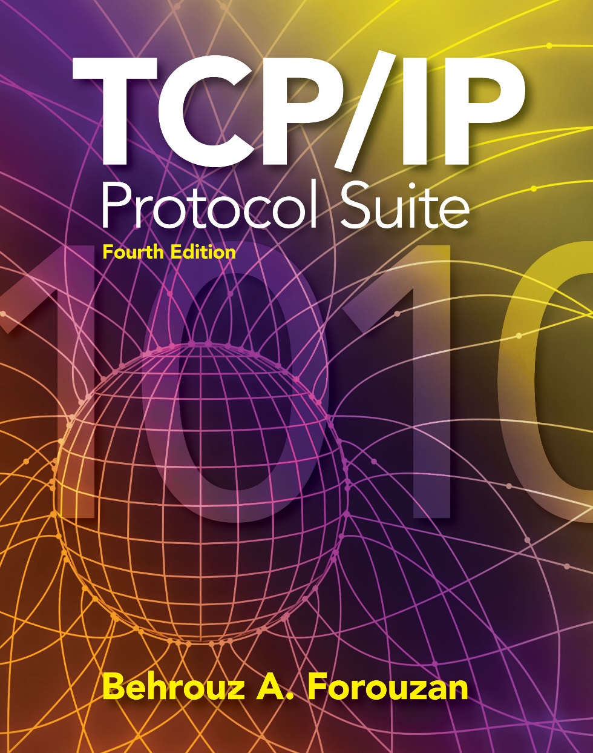
Chapter 11
Unicast Routing
Protocols
Copyright © The McGraw-Hill Companies, Inc. Permission required for reproduction or display.

Slide 2
OBJECTIVES:
To introduce the idea of autonomous systems (ASs) that divide the Internet into smaller administrative regions.
To discuss the idea of distance vector routing and the RIP that is used to implement the idea.
To discuss the idea of link state routing as the second intra-AS routing method and OSPF that is used to implement the idea.
To discuss the idea of path vector routing as the dominant inter-AS routing method and BGP that is used to implement the idea.

Slide 3
Chapter Outline
11.1 Introduction
11.2 Intra- and Inter-Domain Routing
11.3 Distance Vector Routing
11.4 RIP
11.5 Link State Routing
11.6 OSPF
11.7 Path Vector Routing
11.8 BGP

Slide 4
11-1 INTRODUCTION
An internet is a combination of networks connected by routers. When a datagram goes from a source to a destination, it will probably pass through many routers until it reaches the router attached to the destination network.

Slide 5
Topics Discussed in the Section
Cost or Metric
Static versus Dynamic Routing Table
Routing Protocol

Slide 6
Cost or Metric
A router receives a packet from a network and passes it to another network.
When it receives a packet, to which network should it pass the packet?
The decision is based on optimization:
Which of the available pathways is the optimum pathway?
What is the definition of the term optimum?

Slide 7
Static vs Dynamic Routing Table
A routing table can be either static or dynamic.
A static table is one with manual entries.
A dynamic table, on the other hand, is one that is updated automatically when there is a change somewhere in the internet.
Today, an internet needs dynamic routing tables. The tables need to be updated as soon as there is a change in the internet.

Slide 8
Routing Protocol
Routing protocols have been created in response to the demand for dynamic routing tables.
A routing protocol is a combination of rules and procedures that lets routers in the internet inform each other of changes.
It allows routers to share whatever they know about the internet or their neighborhood.
Routing protocols can be either an interior protocol or an exterior protocol. An interior protocol handles intradomain routing; an exterior protocol handles interdomain routing.

Slide 9
11-2 INTER- AND INTRA-DOMAIN ROUTING
Today, an internet can be so large that one routing protocol cannot handle the task of updating the routing tables of all routers. For this reason, an internet is divided into autonomous systems.
An autonomous system (AS) is a group of networks and routers under the authority of a single administration.
Routing inside an autonomous system is called intra-domain routing.
Routing between autonomous systems is called inter-domain routing.

Slide 10
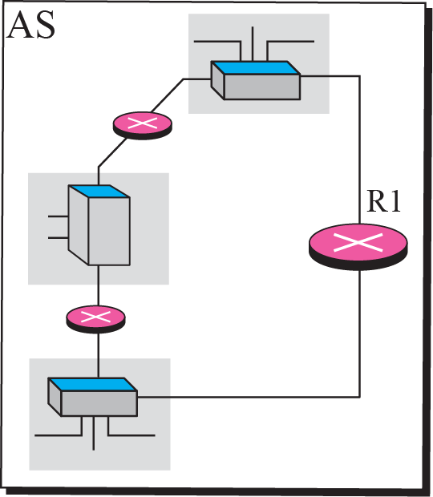
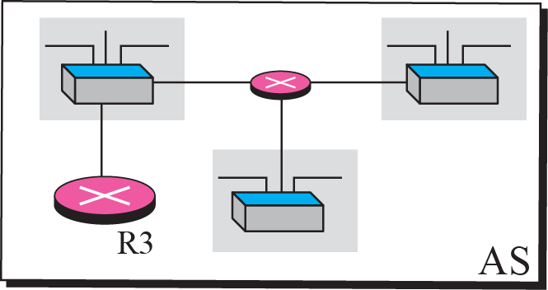
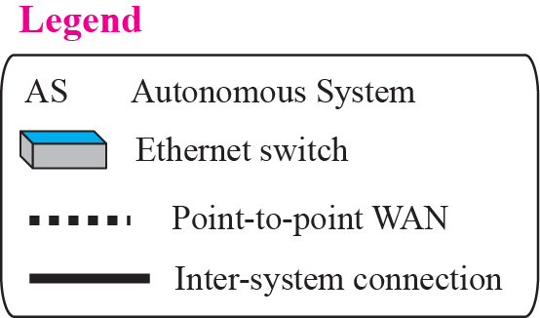
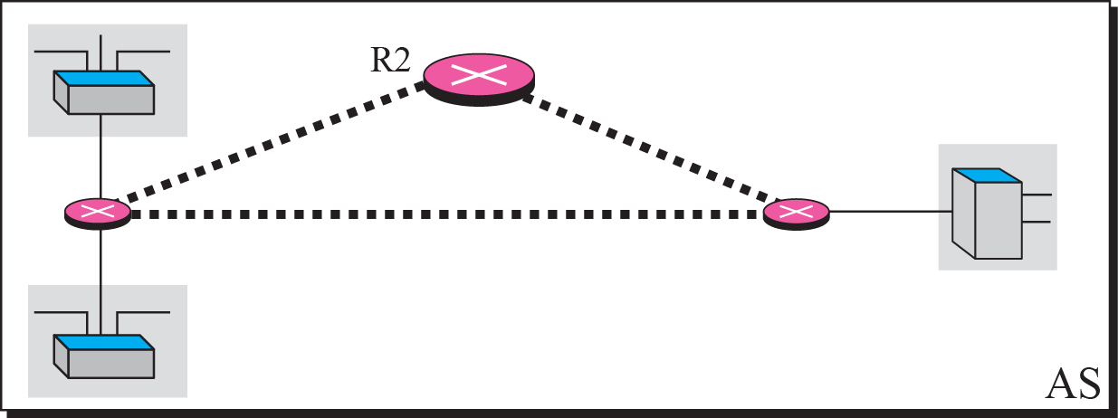
Figure 11.1 Autonomous systems

Slide 11
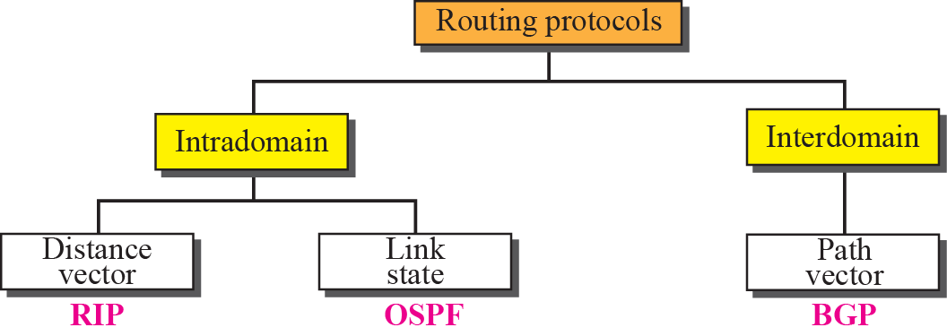
Figure 11.2 Popular routing protocols

Slide 12
11-3 DISTANCE VECTOR ROUTING
This method sees an AS, with all routers and networks, as a graph, a set of nodes and lines (edges) connecting the nodes.
A router can normally be represented by a node and a network by a link connecting two nodes, although other representations are also possible.
The graph theory used an algorithm called Bellman-Ford (also called Ford-Fulkerson) for a while to find the shortest path between nodes in a graph given the distance between nodes.
Notes:
Ford-Fulkerson : “Full” ker “son”

Slide 13
Topics Discussed in the Section
Bellman-Ford Algorithm
Distance Vector Routing Algorithm
Count to Infinity

Slide 14
Bellman-Ford Algorithm

Slide 15
Bellman-Ford Algorithm
The algorithm can be used in many applications in graph theory.
If we know the cost between each pair of nodes, we can use the algorithm to find the least cost (shortest path) between any two nodes.

Slide 16
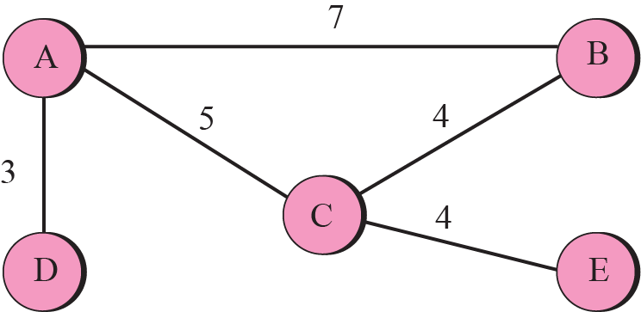
Figure 11.3 A graph for Bellman-Ford algorithm

Slide 17
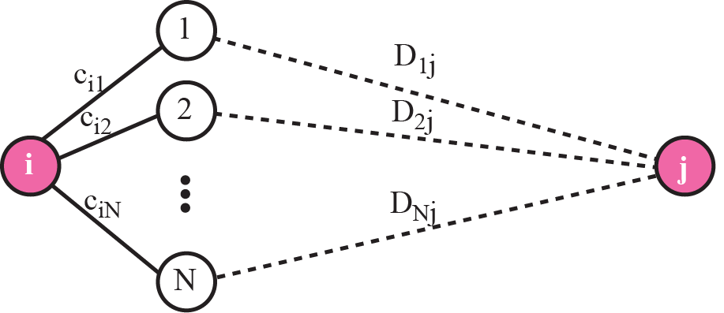
Bellman-Ford Algorithm
The algorithm is based on the fact that:
if all neighbors of node i know the shortest distance to node j,
then the shortest distance between node i and j can be found by adding the distance between node i and each neighbor to the neighbor’s shortest distance to node j and then select the minimum.

Slide 18
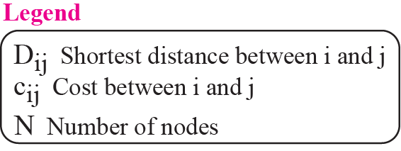
Figure 11.4 The fact behind Bellman-Ford algorithm

Slide 20
Distance Vector Routing Algorithm

Slide 21
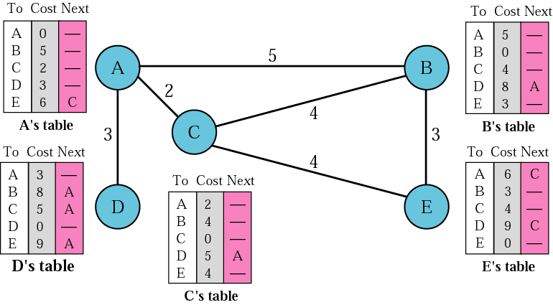
Distance vector routing tables

Slide 22
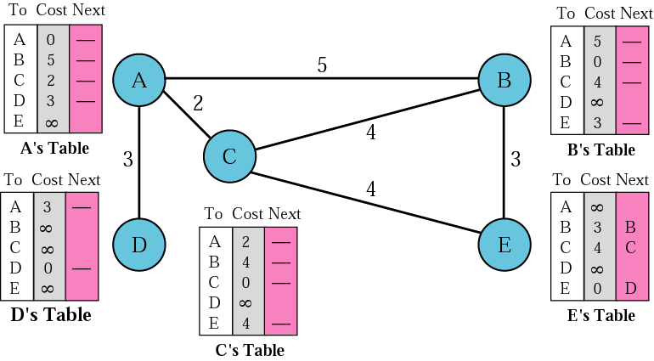
Initialization of tables in distance vector routing

Slide 23
Note:
In distance vector routing, each node shares its routing table with its immediate neighbors periodically and when there is a change.

Slide 24
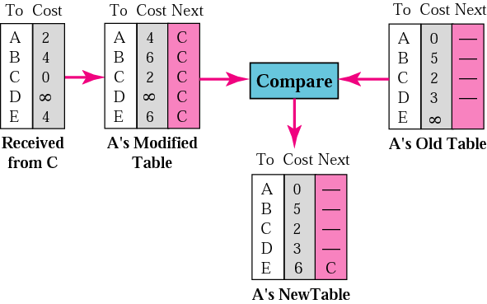
Updating in distance vector routing

Slide 25
Updating Routing Table
If the next-node entry is different
The receiving node chooses the row with the smaller cost
If there is a tie, the old one is kept
If the next-node entry is the same
i.e. the sender of the new row is the provider of the old entry
The receiving node chooses the new row, even though the new value is infinity.

Slide 26
When to Share
Periodic Update
A node sends its routing table, normally 30 seconds, in a periodic update
Triggered Update
A node sends its routing table to its neighbors any time when there is a change in its routing table
1. After updating its routing table, or
2. Detects some failure in the neighboring links

Slide 27
Example 11.1
Figure 11.5 shows the initial routing table for an AS. Note that the figure does not mean that all routing tables have been created at the same time; each router creates its own routing table when it is booted.

Slide 28
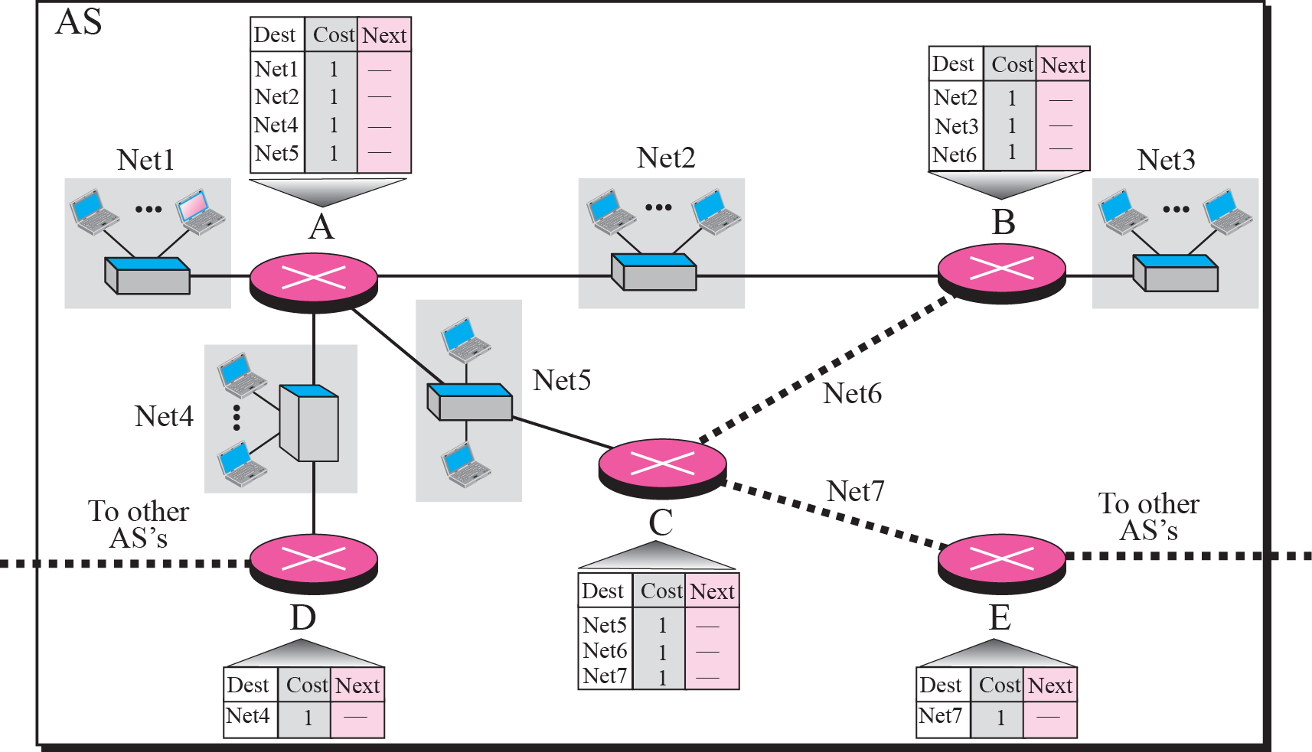
Figure 11.5 Example 11.1

Slide 29
Example 11.2
Now assume router A sends four records to its neighbors, routers B, D, and C. Figure 11.6 shows the changes in B’s routing table when it receives these records. We leave the changes in the routing tables of other neighbors as exercise.

Slide 30
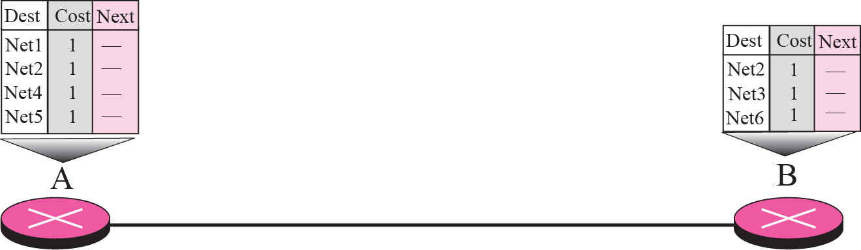
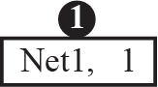
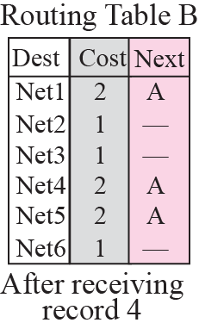
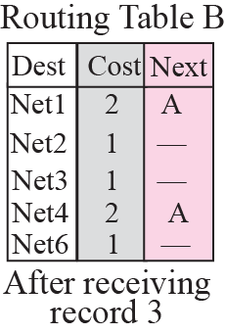
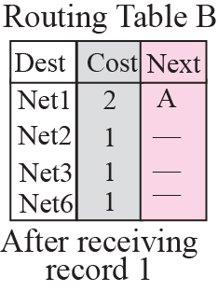
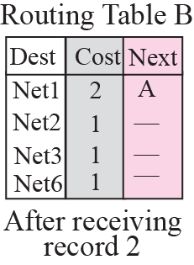
Figure 11.6 Example 11.2

Slide 31
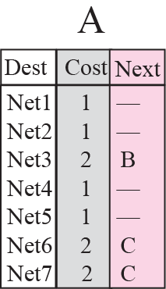
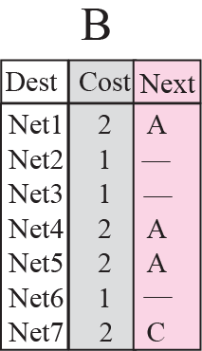
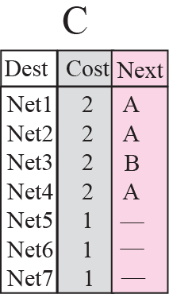
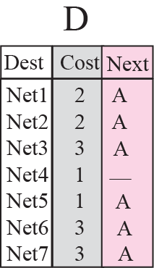
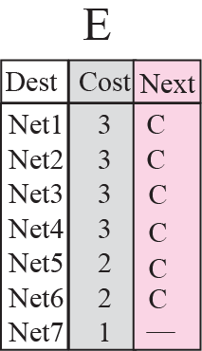
Figure 11.7 Example 11.3

Slide 32
Count to Infinity

Slide 33
Count to Infinity
A problem with distance vector routing is that any decrease in cost (good news) propagates quickly, but any increase in cost (bad news) propagates slowly.
For a routing protocol to work properly, if a link is broken (cost becomes infinity), every other router should be aware of it immediately, but in distance vector routing, this takes some time.
The problem is referred to as count to infinity.
It takes several updates before the cost for a broken link is recorded as infinity by all routers.

Slide 34
Two-Node Instability

Slide 35
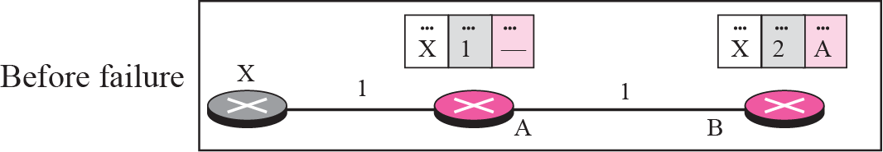
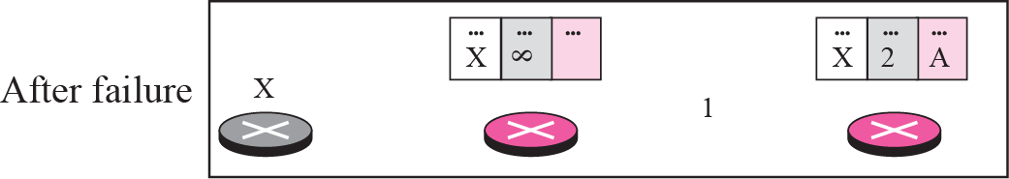
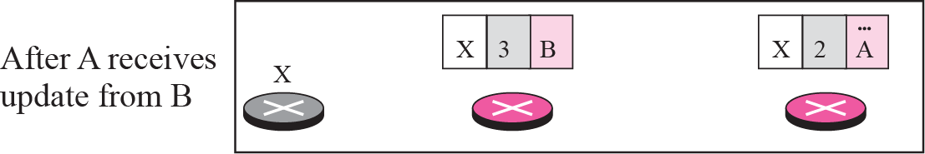
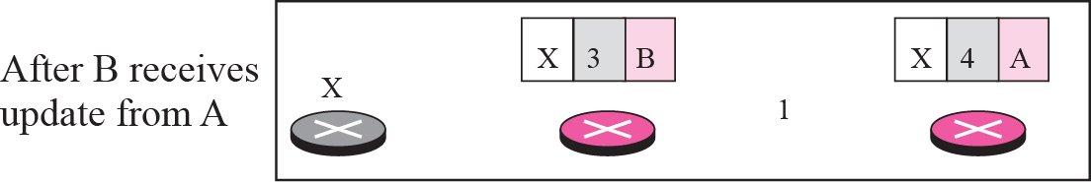
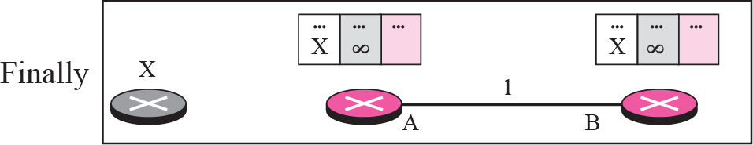
Figure 11.8 Two-node instability

Slide 36
Two node instability Solution
Define Infinity
Split Horizon
Split Horizon and Poison Reverse

Slide 37
Defining Infinity
The first obvious solution is to redefine infinity to a smaller number, such as 16. For our previous scenario, the system will be stable in fewer updates.
As a matter of fact, most implementations of the Distance Vector Protocol define 16 as infinity.
However, this means that distance vector cannot be used in large systems. The size of the network, in each direction, can not exceed 15 hops.

Slide 38
Split Horizon
In this strategy, instead of flooding the table through each interface, each node sends only part of its table through each interface.
If, according to its table, node B thinks that the optimum route to reach X is via A, it does not need to advertise this piece of information to A; the information has come from A (A already knows).
Taking information from node A, modifying it, and sending it back to node A is what creates the confusion.

Slide 39
Split Horizon And Poison Reverse
Normally, the Distance Vector Protocol uses a timer, and if there is no news about a route, the node deletes the route from its table.
When node B in the previous scenario eliminates the route to X from its advertisement to A, node A cannot guess that this is due to the split horizon strategy (the source of information was A) or because B has not received any news about X recently.
The split horizon strategy can be combined with the poison reverse strategy. Node B can still advertise the value for X, but if the source of information is A, it can replace the distance with infinity as a warning: “Do not use this value; what I know about this route comes from you.”

Slide 40
Two-Node Instability (1)
Defining Infinity
Most implementations define 16 as infinity
Split Horizon
Instead of flooding the table through each interface, each node sends only part of its table through each interface
E.g. node B thinks that the optimum route to reach X is via A, it does not need to advertise this piece of information to A

Slide 41
Two-Node Instability (2)
Split Horizon and Poison Reverse
One drawback of Split Horizon
Normally, the DV protocol uses a timer and if there is no news about a route, the node deletes the route from its table
In the previous e.g., node A cannot guess that this is due to split horizon or because B has not received any news about X recently
Poison Reverse
Node B can still advertise the value for X, but if the source of information is A, it can replace the distance with infinity as a warning

Slide 42
Three-Node Instability

Slide 43
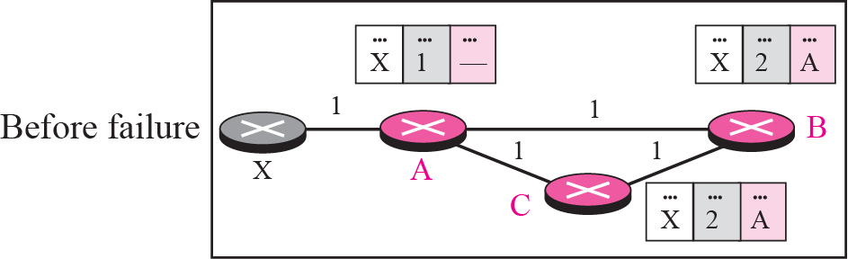
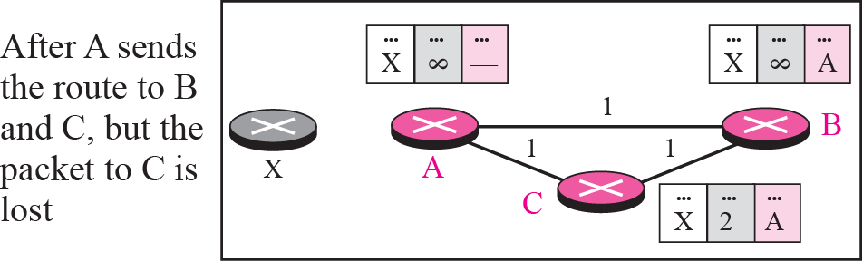
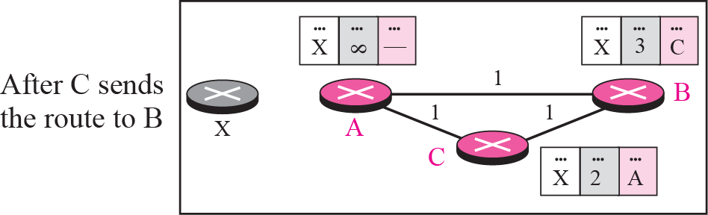
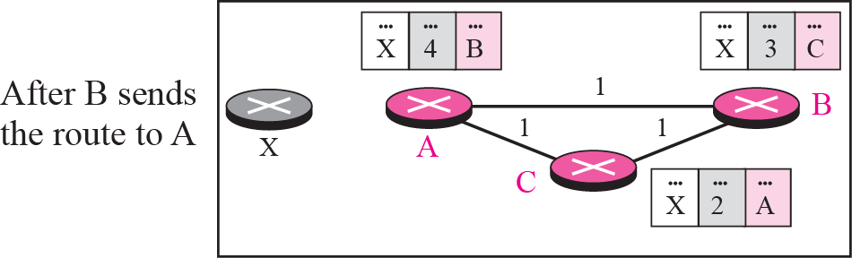
Figure 11.9 Three-node instability
If the instability is btw three nodes, stability cannot be guaranteed
Update loop until infinity

Slide 44
11-4 RIP
The Routing Information Protocol (RIP) is an intra-domain (interior) routing protocol used inside an autonomous system. It is a very simple protocol based on distance vector routing. RIP implements distance vector routing directly with some considerations.

Slide 45
1. In an autonomous system, we are dealing with routers and networks (links), what was described as a node.
2. The destination in a routing table is a network, which means the first column defines a network address.
3. The metric used by RIP is very simple; the distance is defined as the number of links (networks) that have to be used to reach the destination. For this reason, the metric in RIP is called a hop count.
4. Infinity is defined as 16, which means that any route in an autonomous system using RIP cannot have more than 15 hops.
5. The next node column defines the address of the router to which the packet is to be sent to reach its destination.

Slide 46
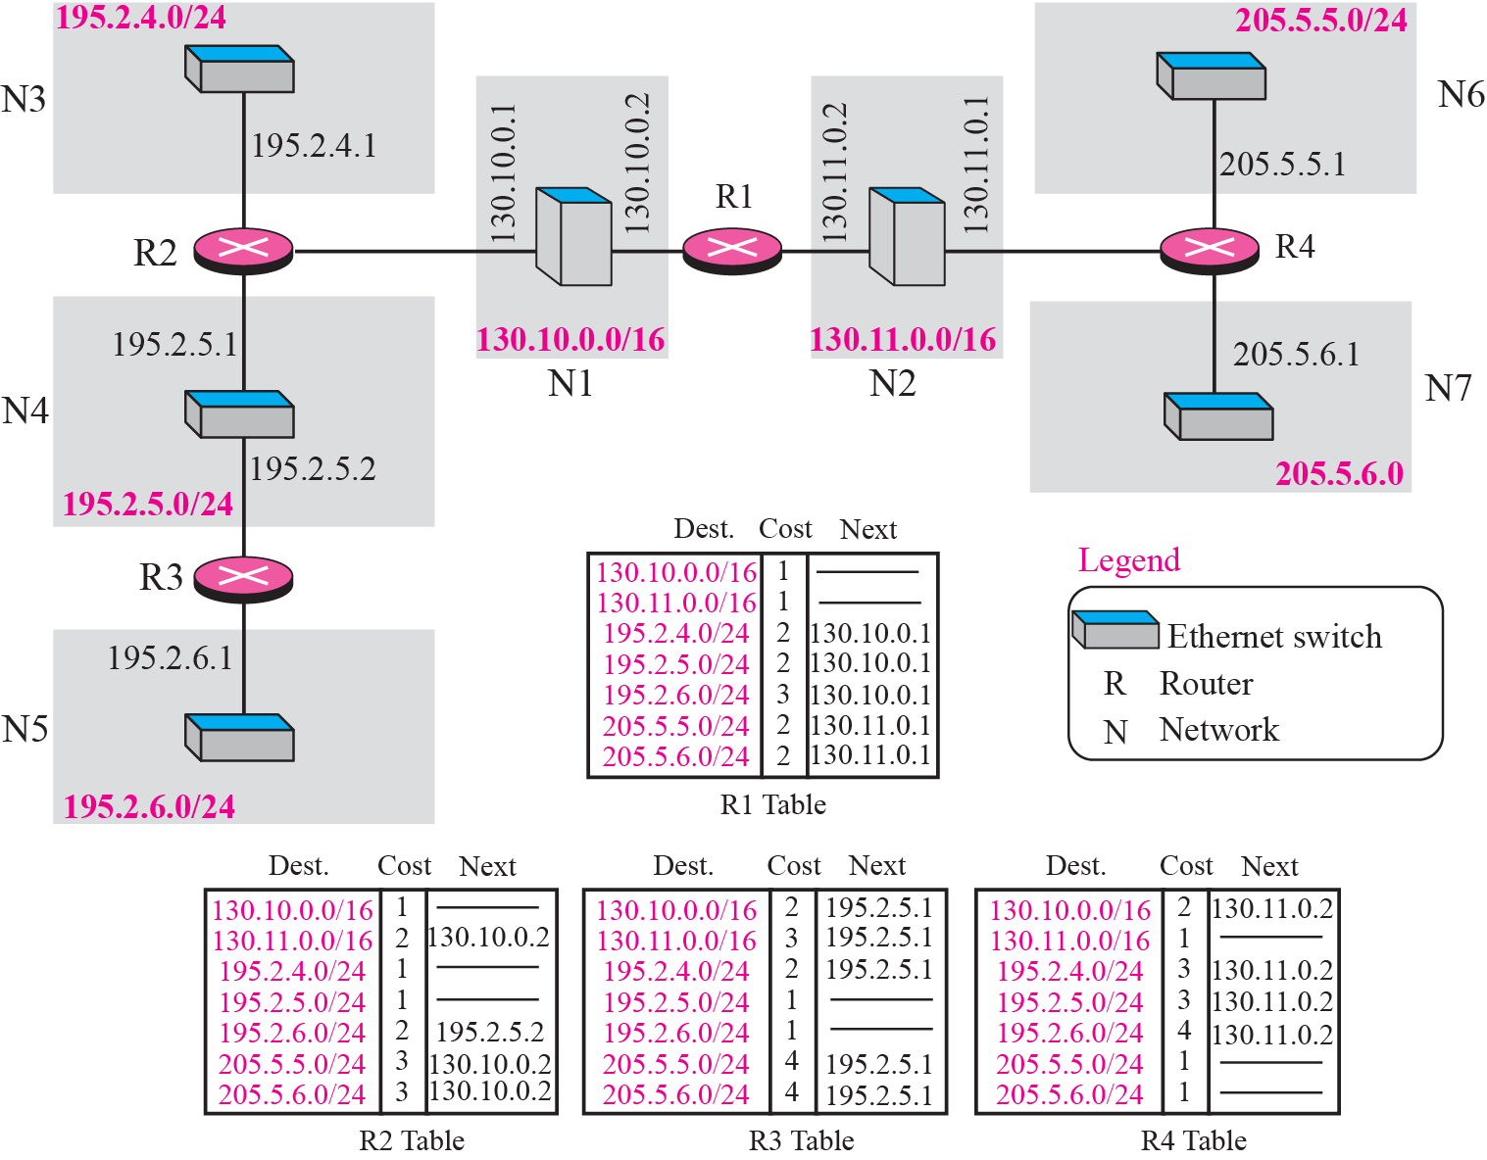
Figure 11.10 Example of a domain using RIP

Slide 47
Topics Discussed in the Section
RIP Message Format
Request and Response
Timers in RIP
RIP Version 2
Encapsulation

Slide 48
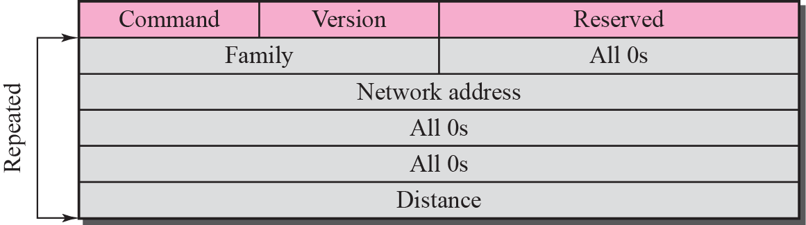
Figure 11.11 RIP message format

Slide 49

RIP message format description
❑ Command. This 8-bit field specifies the type of message: request (1) or response (2).
❑ Version. This 8-bit field defines the version. In this book we use version 1, but at the end of this section, we give some new features of version 2.
❑ Family. This 16-bit field defines the family of the protocol used. For TCP/IP the value is 2.
❑ Network address. The address field defines the address of the destination network. RIP has allocated 14 bytes for this field to be applicable to any protocol. However, IP currently uses only 4 bytes. The rest of the address is filled with 0s.
❑ Distance. This 32-bit field defines the hop count (cost) from the advertising router to the destination network.

Slide 50
RIP messages
Request
A request message is sent by a router that has just come up or by a router that has some time-out entries
A request can ask about specific entries or all entries
Response
A response can be either solicited or unsolicited (30s or when there is a change in the routing table)

Slide 51
Example 11.4
Figure 11.13 shows the update message sent from router R1 to router R2 in Figure 11.10. The message is sent out of interface 130.10.0.2.
The message is prepared with the combination of split horizon and poison reverse strategy in mind. Router R1 has obtained information about networks 195.2.4.0, 195.2.5.0, and 195.2.6.0 from router R2. When R1 sends an update message to R2, it replaces the actual value of the hop counts for these three networks with 16 (infinity) to prevent any confusion for R2. The figure also shows the table extracted from the message. Router R2 uses the source address of the IP datagram carrying the RIP message from R1 (130.10.02) as the next hop address. Router R2 also increments each hop count by 1 because the values in the message are relative to R1, not R2.

Slide 52
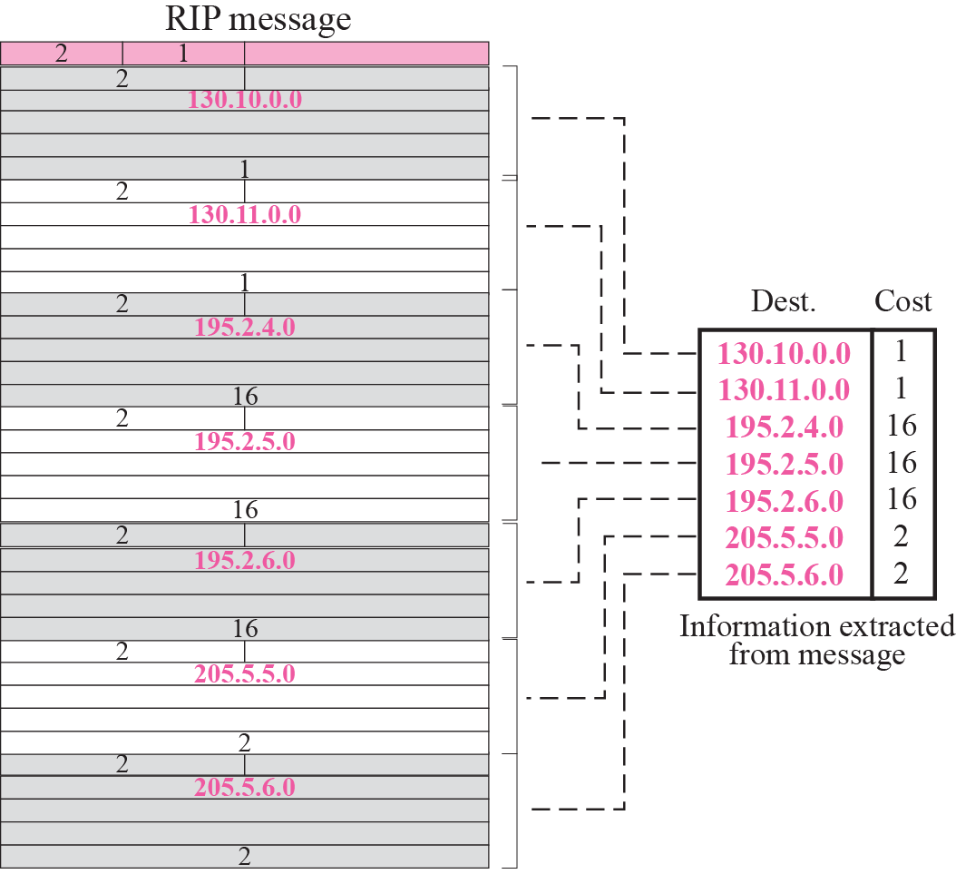
Figure 11.13 Solution to Example 11.4

Slide 53
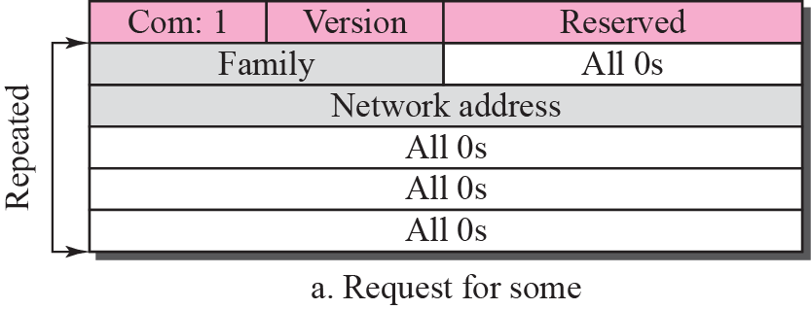
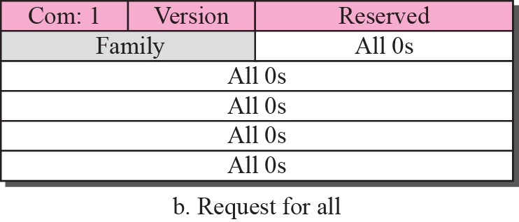
Figure 11.12 Request messages

Slide 54
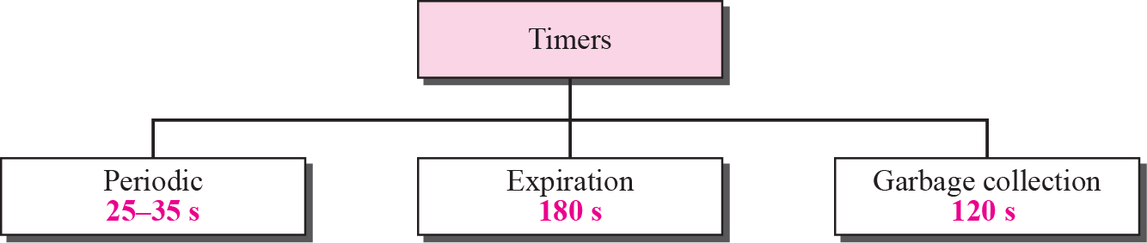
Figure 11.14 RIP timers

Slide 55
RIP Timers
Periodic timer
It controls the advertising of regular update message (25 ~ 30 sec)
Expiration timer
It governs the validity of a route (180 sec)
The route is considered expired and the hop count of the route is set to 16
Garbage collection timer
A invalid route is not purged from the routing table until this timer expires (120 sec)

Slide 56
RIPv2 vs. RIPv1
Classless Addressing
Authentication
Multicasting
RIPv1 uses broadcasting to send RIP messages to every neighbors. Routers as well as hosts receive the packets
RIPv2 uses the all-router multicast address to send the RIP messages only to RIP routers in the network

Slide 57
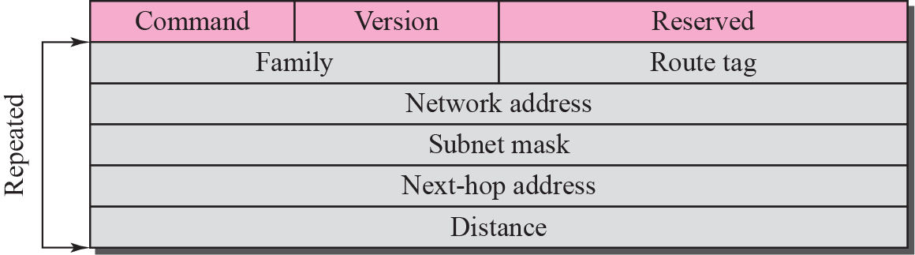
Figure 11.15 RIP version 2 format

Slide 58
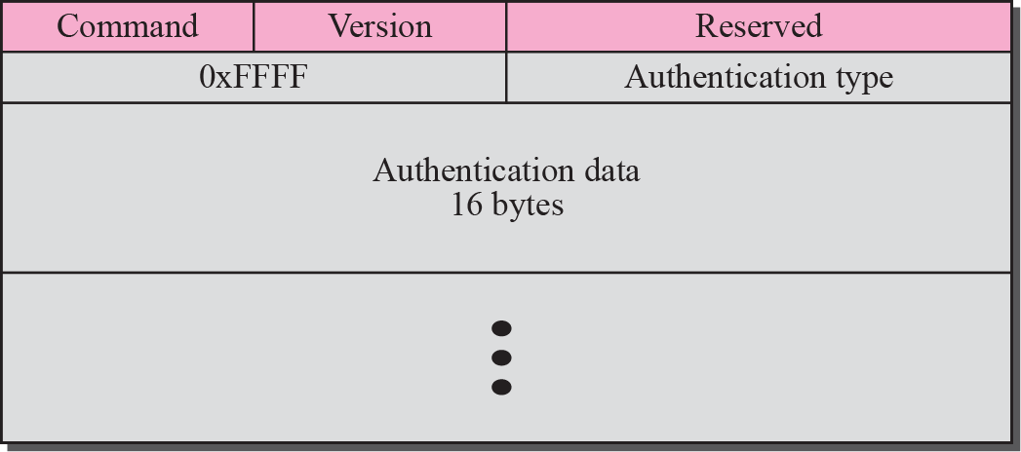
Figure 11.16 Authentication

Slide 59
Example 11.5
A routing table has 20 entries. It does not receive information about five routes for 200 s. How many timers are running at this time?
Solution
The 21 timers are listed below:
Periodic timer: 1
Expiration timer: 20 − 5 = 15
Garbage collection timer: 5

Slide 60

Note
RIP uses the services of UDP on well-known port 520.

Slide 61
11-5 LINK STATE ROUTING
Link state routing has a different philosophy from that of distance vector routing. In link state routing, if each node in the domain has the entire topology of the domain—the list of nodes and links, how they are connected including the type, cost (metric), and the condition of the links (up or down)—the node can use the Dijkstra algorithm to build a routing table.

Slide 62
Topics Discussed in the Section
Building Routing tables

Slide 63
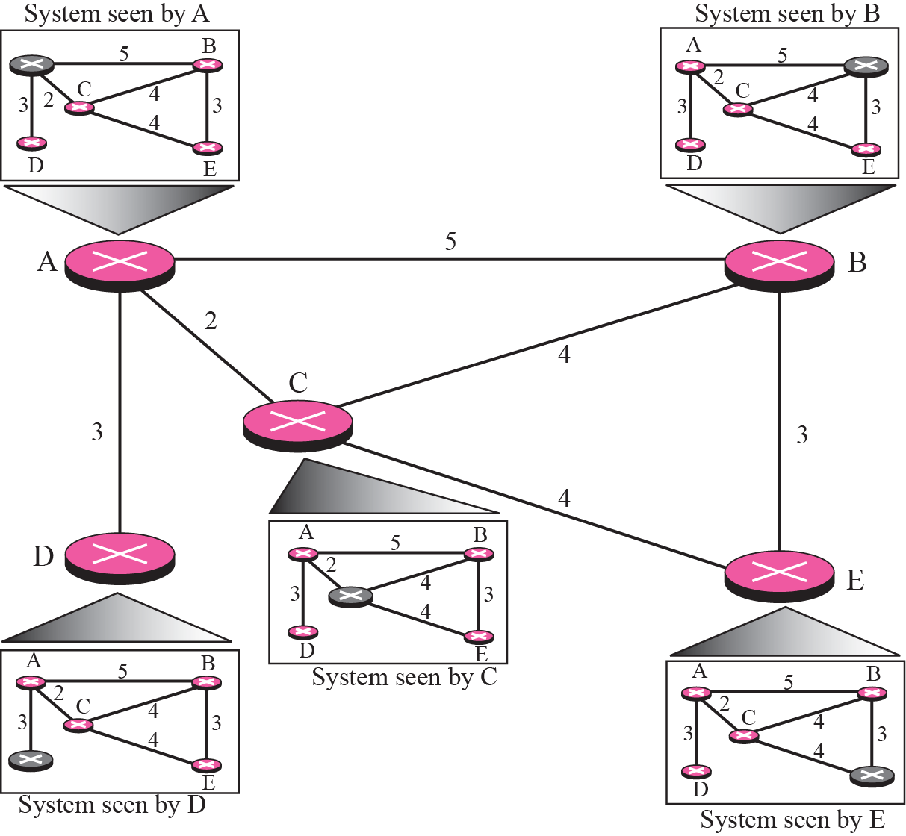
Figure 11.17 Concept of Link state routing

Slide 64
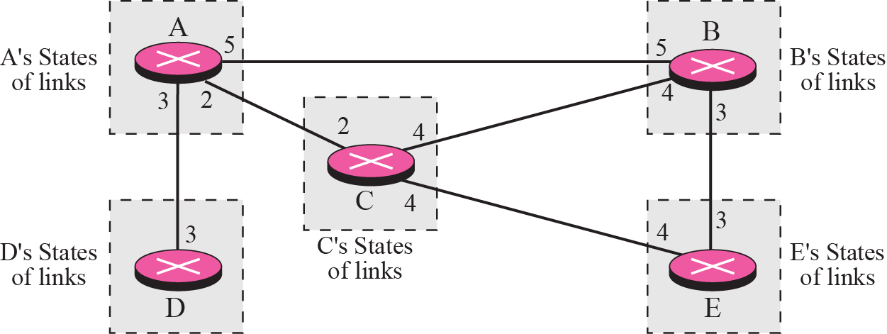
Figure 11.18 Link state knowledge

Slide 65
Building Routing Tables
Creation of the states of the links by each node, called the link state packets (LSP)
Dissemination of LSPs to every other routers, called flooding (efficiently)
Formation of a shortest path tree for each node
Calculation of a routing table based on the shortest path tree

Slide 66
Creation of LSP
LSP data: E.g.
the node ID,
the list of links,
a sequence number,
and age.
LSP Generation
When there is a change in the topology of the domain
On a periodic basis
There is no actual need for this type of LSP, normally 60 minutes or 2 hours

Slide 67
Flooding of LSPs
After a node has prepared an LSP, it must be
disseminated to all other nodes, not only to its neighbors.
1. The creating node sends a copy of the LSP out of each interface.
2. A node that receives an LSP compares it with the copy it may already have. If the newly arrived LSP is older than the one it has (found by checking the sequence number), it discards the LSP. If it is newer, the node does the following:
a. It discards the old LSP and keeps the new one.
b. It sends a copy of it out of each interface except the one from which the packet arrived. This guarantees that flooding stops somewhere in the domain (where a node has only one interface).

Slide 68
Formation of Shortest Path Tree:
Dijkstra Algorithm

Slide 69
Dijkstra Algorithm
After receiving all LSPs, each node will have a copy of the whole topology.
The topology is not sufficient to find the shortest path to every other node; a shortest path tree is needed.
The Dijkstra algorithm is used to create a shortest path tree from a given graph.

Slide 70
Dijkstra Algorithm
1. Initialization:
Select the node as the root of the tree and add it to the path.
Set the shortest distances for all the root’s neighbors to the cost between the root and those neighbors.
Set the shortest distance of the root to zero.
2. Iteration: Repeat the following two steps until all nodes are added to the path:
a. Adding the next node to the path: Search the nodes not in the path. Select the one with minimum shortest distance and add it to the path.
b. Updating: Update the shortest distance for all remaining nodes using the shortest distance of the node just moved to the path in step 2.

Slide 71
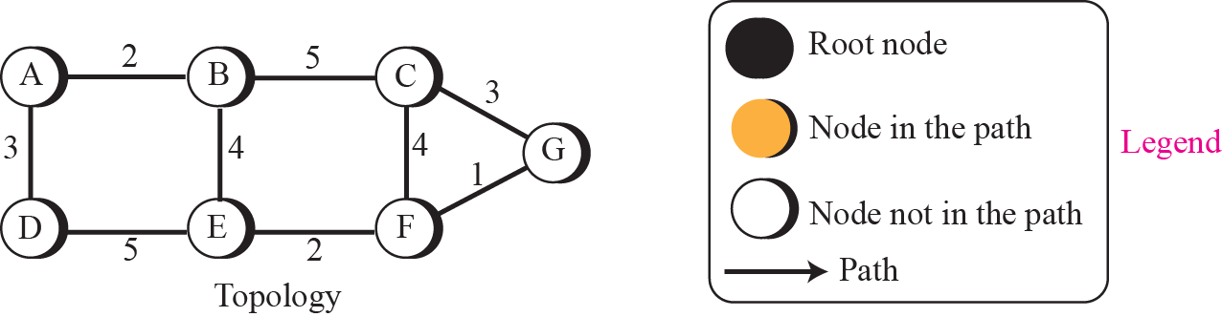
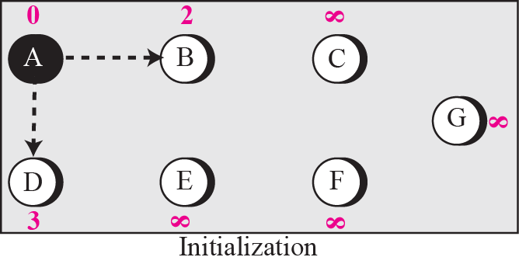
Figure 11.19 Forming shortest path tree for router A in a graph

Slide 72
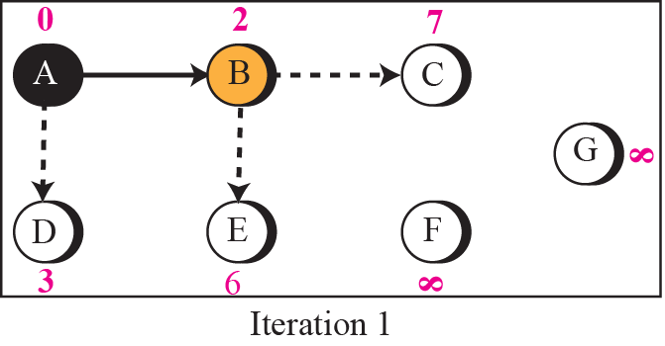
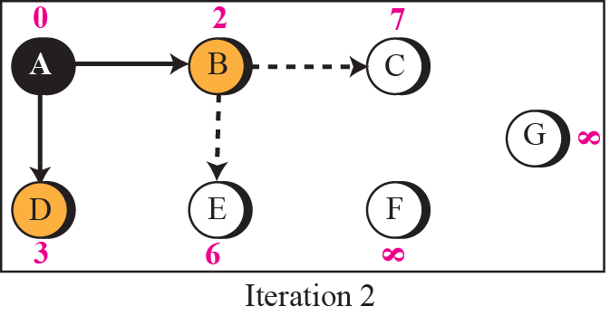
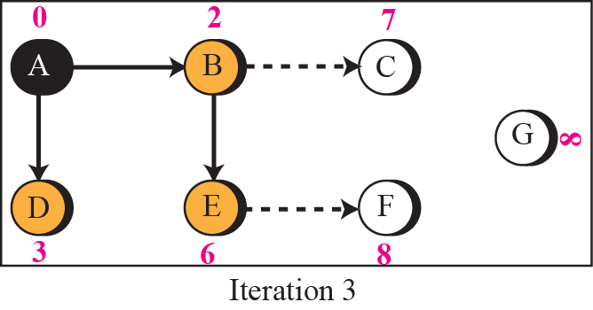
Figure 11.19 Continued

Slide 73
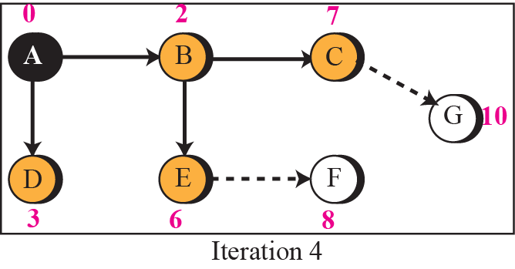
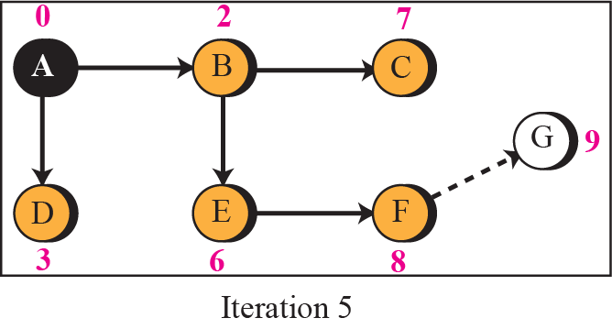

Figure 11.19 Continued

Slide 74
Example 11.6
To show that the shortest path tree for each node is different, we found the shortest path tree as seen by node C (Figure 11.20). We leave the detail as an exercise.

Slide 75

Figure 11.20 Example 11.6

Slide 77
11-6 OSPF
The Open Shortest Path First (OSPF) protocol is an intra-domain routing protocol based on link state routing. Its domain is also an autonomous system.

Slide 78
Topics Discussed in the Section
Area
Metric
Types of Links
Graphical Representation
OSPF Packets
Link State Update Packet
Other Packets
Encapsulation

Slide 79

Figure 11.21 Areas in an autonomous system

Slide 80
Area in OSPF (1)
A collection of networks with area ID
Routers inside an area flood the area with routing information
Area border routers summarize the information about the area and send it to other areas
Backbone area and backbone routers
All of the area inside an AS must be connected to the backbone

Slide 81
Area in OSPF (2)
Virtual link
If, because of some problem, the connectivity between a backbone and an area is broken, a virtual link between routers must be created by the administration to allow continuity of the functions of the backbone as the primary area

Slide 82

Figure 11.22 Types of links

Slide 83


Figure 11.23 Point-to-point link

Slide 84



Figure 11.24 Transient link

Slide 85


Figure 11.25 Stub link

Slide 86

Figure 11.35 Network link

Slide 87

Figure 11.40 Summary link to network

Slide 88

Figure 11.42 Summary link to AS boundary router

Slide 89

Figure 11.44 External link

Slide 90
Note
OSPF packets are encapsulated in IP datagrams.

Slide 91
11-7 PATH VECTOR ROUTING
Distance vector and link state routing are both interior routing protocols. They can be used inside an autonomous system. Both of these routing protocols become intractable when the domain of operation becomes large. Distance vector routing is subject to instability if there is more than a few hops in the domain of operation. Link state routing needs a huge amount of resources to calculate routing tables. It also creates heavy traffic because of flooding. There is a need for a third routing protocol which we call path vector routing.

Slide 92
Path Vector Routing
Path vector routing is exterior routing protocol proved to be useful for interdomain or inter-AS routing.
In distance vector routing, a router has a list of networks that can be reached in the same AS with the corresponding cost (number of hops).
In path vector routing, a router has a list of networks that can be reached with the path (list of ASs to pass) to reach each one.
In other words, the domain of operation of the distance vector routing is a single AS; the domain of operation of the path vector routing is the whole Internet. The distance vector routing tells us the distance to each network; the path vector routing tells us the path.

Slide 93
Topics Discussed in the Section
Reachability
Routing Table

Slide 94
Example 11.10
The difference between the distance vector routing and path vector routing can be compared to the difference between a national map and an international map. A national map can tell us the road to each city and the distance to be traveled if we choose a particular route; an international map can tell us which cities exist in each country and which countries should be passed before reaching that city.

Slide 95




Figure 11.50 Reachability

Slide 96
Routing Tables
Loop Prevention
Aggregation
Policy Routing

Slide 97



Figure 11.51 Stabilized table for three autonomous system

Slide 98
Loop Prevention
The instability of distance vector routing and the creation of loops can be avoided in path vector routing.
When a router receives a reachability information, it checks to see if its autonomous system is in the path list to any destination.
If it is, looping is involved and that network-path pair is discarded.

Slide 99
Aggregation
The path vector routing protocols normally support CIDR notation and the aggregation of addresses (if possible).
This helps to make the path vector routing table simpler and exchange between routers faster.

Slide 100



Figure 11.52 Routing tables after aggregation

Slide 101
Figure 11.52 Routing tables after aggregation

Slide 102
Policy Routing
Policy routing can be easily implemented through path vector routing.
When a router receives a message, it can check the path.
If one of the autonomous systems listed in the path is against its policy, it can ignore that path and that destination.
It does not update its routing table with this path, and it does not send this message to its neighbors.

Slide 103
11-8 BGP
Border Gateway Protocol (BGP) is an interdomain routing protocol using path vector routing. It first appeared in 1989 and has gone through four versions.

Slide 104
Topics Discussed in the Section
Types of Autonomous Systems
Path Attributes
BGP Sessions
External and Internal BGP
Types of Packets
Packet Format
Encapsulation

Slide 105
Figure 11.53 BGP sessions
The exchange of routing information between two routers using BGP takes place in a session.
A session is a connection that is established between two BGP routers only for the sake of exchanging routing information.
To create a reliable environment, BGP uses the services of TCP. In other words, a session at the BGP level, as an application program, is a connection at the TCP level.
However, there is a subtle difference between a connection in TCP made for BGP and other application programs. When a TCP connection is created for BGP, it can last for a long time, until something unusual happens. For this reason, BGP sessions are sometimes referred to as semipermanent connections.

Slide 106


Figure 11.53 Internal and external BGP sessions
A speaker node advertises the path, not the metric of the nodes, in its AS or other ASs.

Slide 107
Path Vector Routing (1)
Sharing
A speaker in an AS shares its table with immediate neighbors
Updating
Adding the nodes that are not in its routing table and adding its own AS and the AS that sent the table
The routing table shows the path completely

Slide 108
Path Vector Routing (2)
Loop prevention
A route checks to see if its AS is in the path list to the destination
Policy routing
If one of the ASs listed in the path is against its policy, it can ignore that path and that destination
It does not update its routing table with the path, and it does not send this message to its neighbors

Slide 109
Path Vector Routing (3)
Optimum path
Problem: each AS that is included in the path may use a different criteria for the metric
The optimum path is the path that fits the organization
For Fig. 14-49, the author chose the one that had the smaller number of ASs
Other criteria: security, safety, reliability, etc.

Slide 110
Types of AS
Stub AS
Only one connection to another AS (only a source or sink for data traffic)
Multihomed AS
More than one connection to other AS, but it is still only a source or sink for data traffic
Transit AS
Multihomed AS that also allows transient traffic

Slide 111

Figure 11.54 Types of BGP messages

Slide 112

Figure 11.55 BGP packet header

Slide 113

Figure 11.56 Open message

Slide 114

Figure 11.57 Update message

Slide 115
Path Attributes
ORIGIN
The source of the routing information (RIP, OSPF, etc)
AS_PATH
The list of ASs through which the destination can be reached
NEXT-HOP
The next router to which the data packet should be sent

Slide 116
NLRI
Network layer reachability information
It defines the network that is actually advertised by this message
Length field and IP address prefix
BGP4 supports classless addressing and CIDR

Slide 117
Note
BGP supports classless addressing and CIDR.

Slide 118

Figure 11.58 Keepalive message

Slide 119

Figure 11.59 Notification message

Slide 120


Slide 121
Note
BGP uses the services of TCP on port 179.

